Slide 1
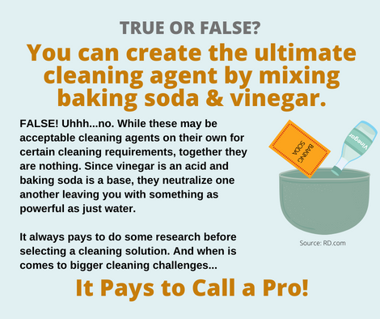
Cleaning and Removing Pet Urine
They say that a dog is man’s best friend, but really, any pet you choose to adopt into your family can be your best friend. It can be a dog, cat, turtle, dinosaur, a bird. A pet is a pet. Just kidding about the dinosaur; we all know they are too expensive to feed.
While you want your pets to behave, be a good family member, they have the occasional (hopefully not that often) accidents. Yes, we are speaking of when they pee on the floor. And mainly dogs and cats.
The “accidents” can occur for a variety of reasons. It could be a pet is sick, or left alone too long, or is mad because you didn’t give them their favorite treat. A host of reasons. The bottom line, though, is you have a mess to clean up. It could be a small mess, or a big one, depending on the size of your pet.
The first thing to do is act quickly. A pet accident on a hard surface is one thing, easy to wipe up, clean, and disinfect. A pet accident on a carpeted surface is something else altogether. This tip will concentrate on soft surfaces, such as carpet.
When a pet accident does occur, it’s important to remove as much as possible right away. Using only white paper or cloth disposable towels, blot the area until no more moisture transfers. If you have a wet/dry vacuum and don’t mind using it for this chore, vacuuming up the offending mess is a great way to remove most of the contaminant.
Next you need to clean the area. It’s always best to use a cleaning product you get from your favorite cleaning company, or something approved for cleaning spots on carpet. Apply the solution sparingly, work it in, and use an absorbent towel or the wet/dry vacuum to pick it up. Repeat several times, flushing out the area.
If you don’t get all the urine out of the carpet, and remember the urine can be in the padding, the odors may become strong, and your pet will know what’s there and return to it — it’s possible.
While you may attempt all this and even be successful at times, there’s just one way to guarantee the best removal of pet spots, stains, and odors. Call your favorite cleaning company. After all, it pays to call a pro!

Slide 2
Homeowner Beware: Major Causes of Home Fires
Any type of disaster in your home is devastating. Whether a flooded basement, strong wind that tears off part of your roof, a broke pipe spewing water all over the place, the resulting damage and cost of repair and remediation can be very costly.
Besides total destruction of your home, such as from a hurricane or tornado, a house fire is at the top of the list of devastation. A house fire can be limited to just one area, or it can also destroy your entire home.
Even a small house fire is extremely difficult to deal with and repair. The best strategy is to avoid them at all costs and understanding what causes most fires in the home is the first step. If you know what is most dangerous, you can plan to avoid dangerous situations.
In the United States, according to the National Fire Protection Association, the #1 cause of a house fire is cooking. It is the most common and includes personal injury as well. Cooking represents nearly half of all home fires, and 20 percent of home fire deaths. This might give you a sobering pause the next time you cook up a big meal. When you plan to work in the kitchen, make sure open flames are kept to a minimum and flammables are nowhere near them. Don’t leave anything cooking in a pot unattended. And be sure to have the proper fire extinguisher handy.
The NFPA indicates the second cause of home fires is from your heating system. Trying to stay warm in colder weather accounted for nearly 50,000 fires annually
during the period of 2014-2018. Be sure that your heating equipment, whether installed or portable, is always in good shape and you follow manufacturer directions. Proper inspections and safety checks are a must.
The third most common cause of house fires is due to electrical issues. Expert sources report close to 50,000 home electrical fires occur each year, mostly due to wiring, lighting, cords, and plug failure. Simply inspecting, replacing, and using proper equipment could mean avoiding a dangerous fire. Too many of us use shortcuts (improper extension cords, electrical tape to fix a cut in a cord, etc.) when using electricity.
Those are the top three causes of house fires. There are many more. Be aware of them and be smart. Prevent them from happening in the first place. But if the unthinkable does happen, do the right thing to fix it all. Call your favorite restoration company. After all, it pays to call a pro!

